Slide 1
Nearest neighbor classifier
Lee-Ad Gottlieb

Slide 2
Classifiers
Classifiers we’ve previously seen
Intervals, lines, hyperplanes, rectangles, balls
We’ve implicitly assumed Euclidean space
This isn’t the only distance measure out there!

Slide 3
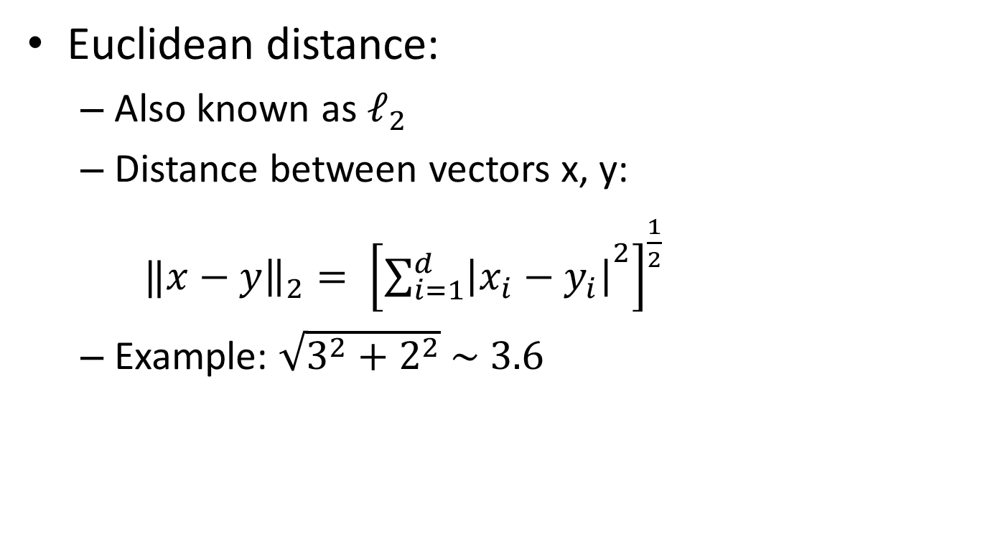
Euclidean space
Euclidean distance:
Also known as $ℓ_{2}$
Distance between vectors x, y:
$‖x−y{\left.​\right\|}_{2}= {\left[{\sum_{i=1}^{d}{\left|x_{i}−y_{i}\right|}}^{2}\right]}^{\frac{1}{2}}$
Example: $\sqrt{3^{2}+2^{2}} \sim 3.6$
y=(6,3)
2
x=(3,1)
3

Slide 4
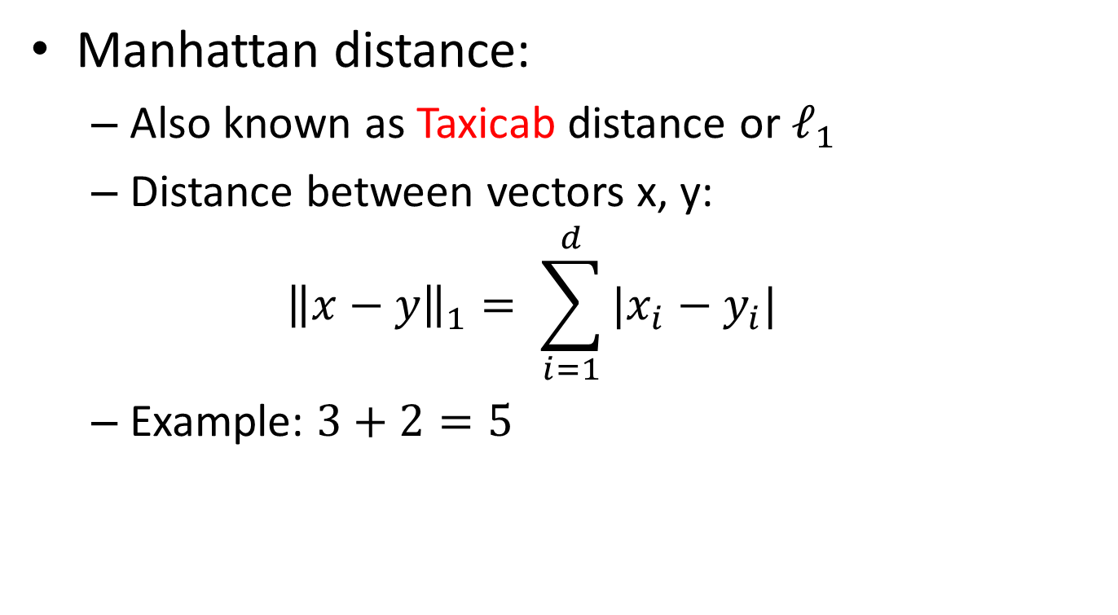
Manhattan norm
Manhattan distance:
Also known as Taxicab distance or $ℓ_{1}$
Distance between vectors x, y:
$${\left\|x−y\right\|}_{1}= \sum_{i=1}^{d}{|x_{i}−y_{i}| }$$
Example: $3+2=5$
y=(6,3)
2
x=(3,1)
3

Slide 5
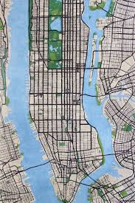
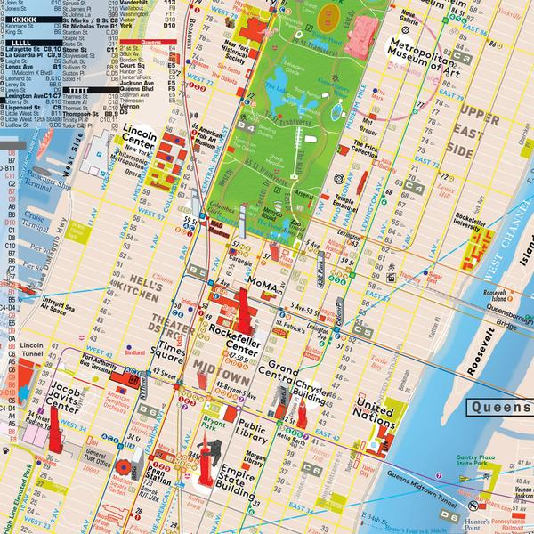
By the way…
Taking a taxicab in Manhattan
But technically, Manhattan is on an angle

Slide 6
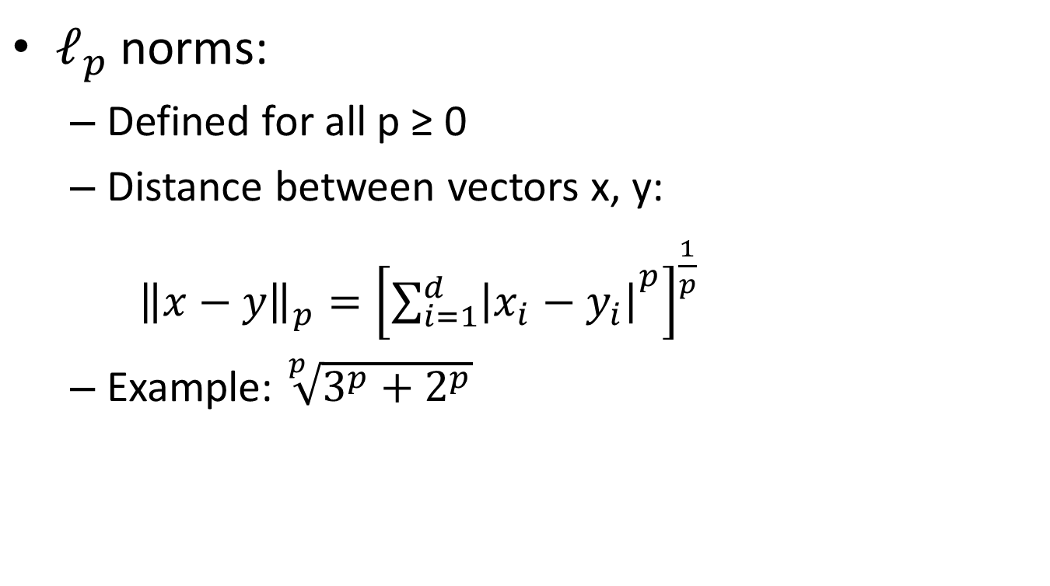

$ℓ_{p}$space
$ℓ_{p}$norms:
Defined for all p ≥ 0
Distance between vectors x, y:
${\left\|x−y\right\|}_{p}={\left[{\sum_{i=1}^{d}{\left|x_{i}−y_{i}\right|}}^{p}\right]}^{\frac{1}{p}}$
Example: $\sqrt[p]{3^{p}+2^{p}}$
y=(6,3)
2
x=(3,1)
3

Slide 7
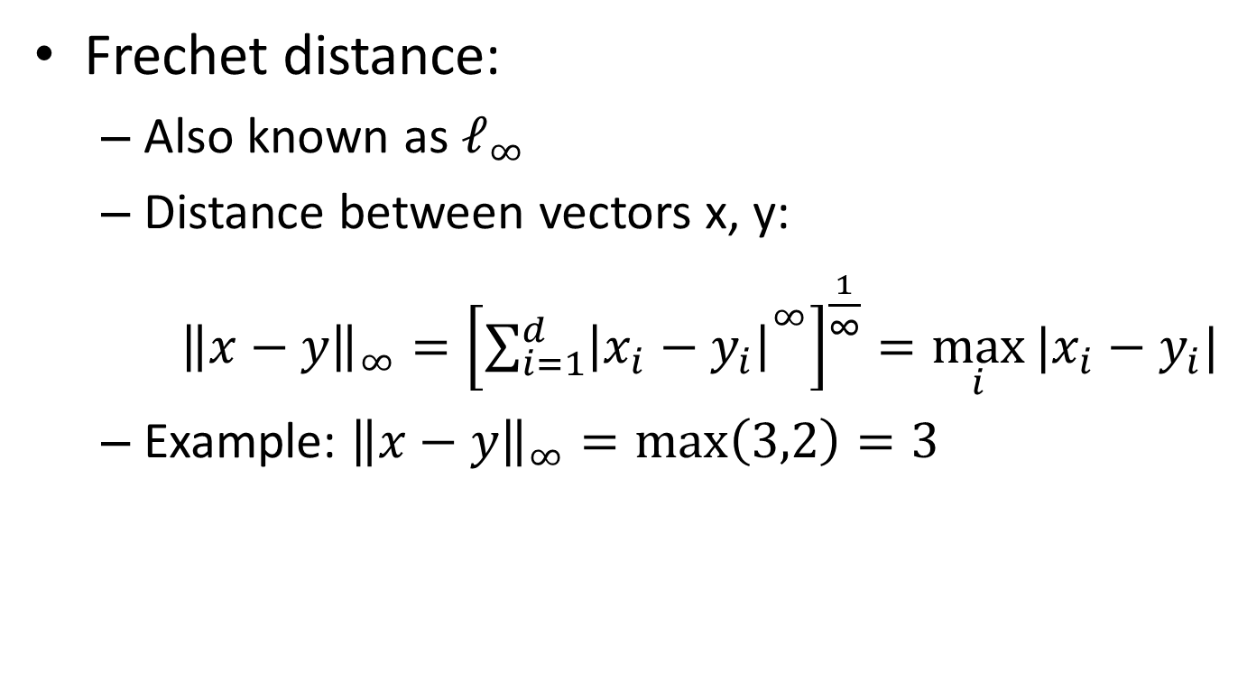
Frechet distance
Frechet distance:
Also known as $ℓ_{∞}$
Distance between vectors x, y:
${\left\|x−y\right\|}_{∞}={\left[{\sum_{i=1}^{d}{\left|x_{i}−y_{i}\right|}}^{∞}\right]}^{\frac{1}{∞}}=\max_{i}{|x_{i}−y_{i}|}$
Example: ${\left\|x−y\right\|}_{∞}=max\left(3,2\right)=3$
y=(6,3)
2
x=(3,1)
3

Slide 8
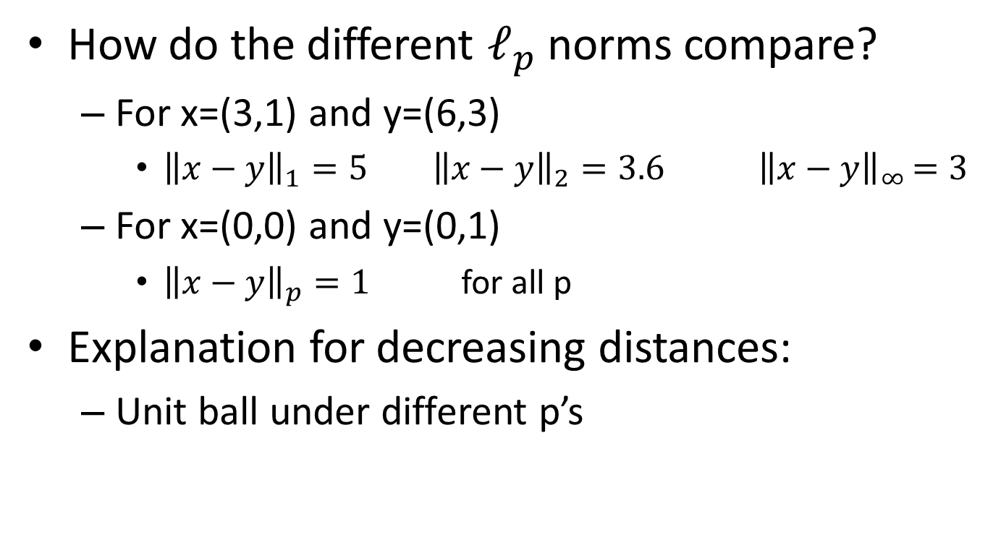

Comparing $ℓ_{p}$spaces
How do the different $ℓ_{p}$norms compare?
For x=(3,1) and y=(6,3)
${\left\|x−y\right\|}_{1}=5 {\left\|x−y\right\|}_{2}=3.6$ ${ \left\|x−y\right\|}_{∞ }=3$
For x=(0,0) and y=(0,1)
${\left\|x−y\right\|}_{p}=1$ for all p
Explanation for decreasing distances:
Unit ball under different p’s
(1,0)
(1,0)
(1,0)
(1,0)
l_{1/2}
l₁
l₂
l∞

Slide 9
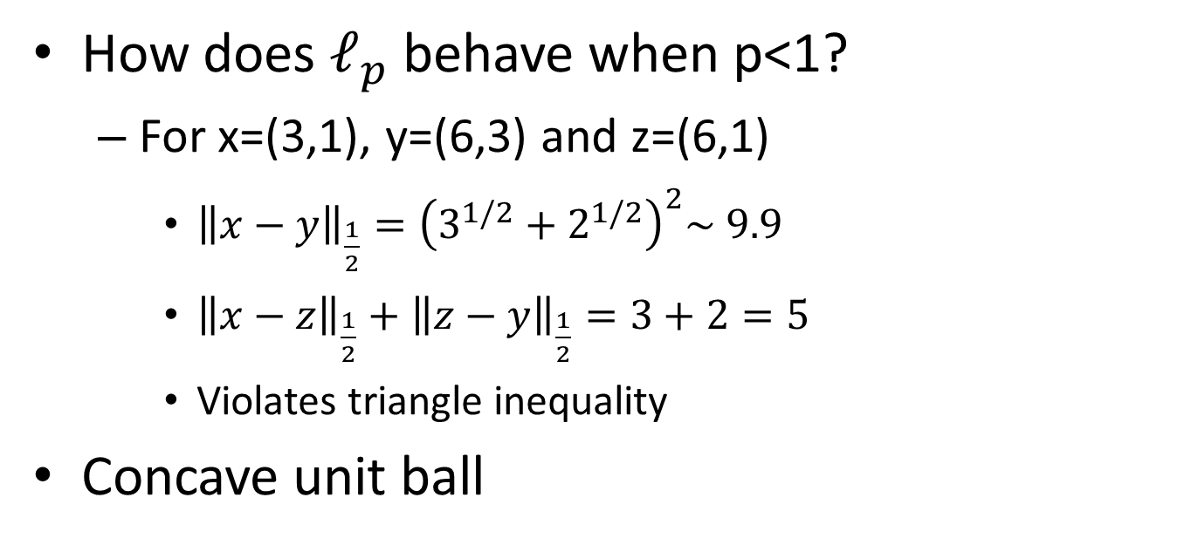

Fractional $ℓ_{p}$spaces
How does $ℓ_{p}$ behave when p<1?
For x=(3,1), y=(6,3) and z=(6,1)
${\left\|x−y\right\|}_{\frac{1}{2}}={\left(3^{1/2}+2^{1/2}\right)}^{2}\sim 9.9$
${\left\|x−z\right\|}_{\frac{1}{2}}+{\left\|z−y\right\|}_{\frac{1}{2}}=3+2=5$
Violates triangle inequality
Concave unit ball
y=(6,3)
x=(3,1)
2
3
z=(6,1)
(1,0)
(1,0)
(1,0)
(1,0)
l_{1/2}
l₁
l₂
l∞

Slide 10
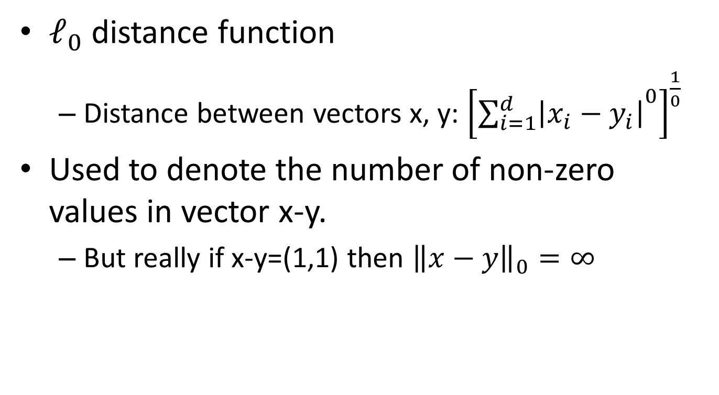

What is $ℓ_{0}?$
$ℓ_{0}$ distance function
Distance between vectors x, y: ${\left[{\sum_{i=1}^{d}{\left|x_{i}−y_{i}\right|}}^{0}\right]}^{\frac{1}{0}}$
Used to denote the number of non-zero values in vector x-y.
But really if x-y=(1,1) then ${\left\|x−y\right\|}_{0}=∞$

Slide 11
What is a metric?
A metric obeys
Symmetry: d(x,y) = d(y,x)
Triangle inequality: d(x,y) ≤ d(x,z) + d(z,y)
A semi-metric obeys
Symmetry only
A quasi-metric obeys
Triangle inequality only
x
y
z
x
y

Slide 12

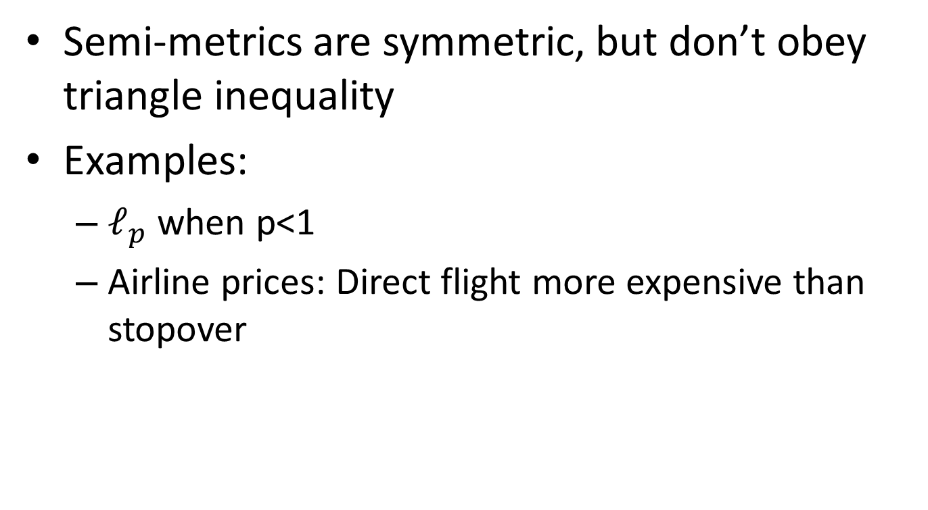
Semi-metrics
Semi-metrics are symmetric, but don’t obey triangle inequality
Examples:
$ℓ_{p}$ when p<1
Airline prices: Direct flight more expensive than stopover

Slide 13
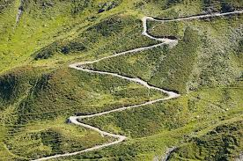
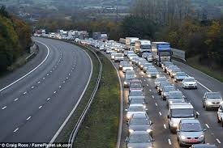
Quasi-metrics
Quasi-metrics obey the triangle inequality, but aren’t symmetric
Examples:
Travel distances (uphill, traffic)

Slide 14
Other distance functions
Consider trying to match a string to its nearest neighbor.
Google search
autocomplete
“hello world”
Deletion: “helo world”
Insertion: “othello world”
Substitution: “hallo world”

Slide 15
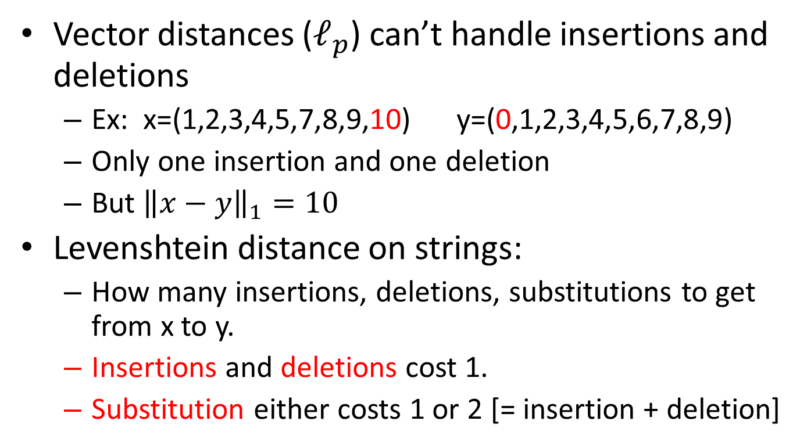
Levenshtein distance
Vector distances ($ℓ_{p}$) can’t handle insertions and deletions
Ex: x=(1,2,3,4,5,7,8,9,10) y=(0,1,2,3,4,5,6,7,8,9)
Only one insertion and one deletion
But ${\left\|x−y\right\|}_{1}=10$
Levenshtein distance on strings:
How many insertions, deletions, substitutions to get from x to y.
Insertions and deletions cost 1.
Substitution either costs 1 or 2 [= insertion + deletion]

Slide 16
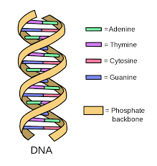
DNA
A good example for Levenshtein distance is for DNA strings
4 basic amino acids:
Adenine, Cytosine, Guanine, Thymine
What’s the distance from
GGCTAG to GCGCAA ?
GGCTAG → GCGCTAG → GCGCAG → GCGCAA
Insertion, deletion, substitution = 3

Slide 17
Levenshtein distance
Also called edit distance
Can be computed as a dynamic program
Actually computes distances between all prefix of s,t
Run-time: O(|s|*|t|)

Slide 18
DNA – dynamic program
 | - | G | C | G | C | A | A
-
G
G
C
T
A
G
d(GG, GCGC)
d(GGCTA, GCG)

Slide 19
DNA – dynamic program
 | - | G | C | G | C | A | A
- | 0
G
G
C
T
A
G
d(empty string, empty string) = 0

Slide 20
DNA – dynamic program
 | - | G | C | G | C | A | A
- | 0 | 1 | 2 | 3 | 4 | 5 | 6
G | 1
G | 2
C | 3
T | 4
A | 5
G | 6
= insertion at cost 1

Slide 21
DNA – dynamic program
 | - | G | C | G | C | A | A
- | 0 | 1 | 2 | 3 | 4 | 5 | 6
G | 1 | 0 | 1 | 2 | 3 | 4 | 5
G | 2
C | 3
T | 4
A | 5
G | 6
= insertion of G to both at cost 0

Slide 22
DNA – dynamic program
 | - | G | C | G | C | A | A
- | 0 | 1 | 2 | 3 | 4 | 5 | 6
G | 1 | 0 | 1 | 2 | 3 | 4 | 5
G | 2 | 1 | 1 | 1 | 2 | 3 | 4
C | 3
T | 4
A | 5
G | 6
= insertion of G and C = substitution at cost 1

Slide 23
DNA – dynamic program
 | - | G | C | G | C | A | A
- | 0 | 1 | 2 | 3 | 4 | 5 | 6
G | 1 | 0 | 1 | 2 | 3 | 4 | 5
G | 2 | 1 | 1 | 1 | 2 | 3 | 4
C | 3 | 2 | 1 | 2 | 1 | 2 | 3
T | 4
A | 5
G | 6

Slide 24
DNA – dynamic program
 | - | G | C | G | C | A | A
- | 0 | 1 | 2 | 3 | 4 | 5 | 6
G | 1 | 0 | 1 | 2 | 3 | 4 | 5
G | 2 | 1 | 1 | 1 | 2 | 3 | 4
C | 3 | 2 | 1 | 2 | 1 | 2 | 3
T | 4 | 3 | 2 | 2 | 2 | 2 | 3
A | 5
G | 6

Slide 25
DNA – dynamic program
 | - | G | C | G | C | A | A
- | 0 | 1 | 2 | 3 | 4 | 5 | 6
G | 1 | 0 | 1 | 2 | 3 | 4 | 5
G | 2 | 1 | 1 | 1 | 2 | 3 | 4
C | 3 | 2 | 1 | 2 | 1 | 2 | 3
T | 4 | 3 | 2 | 2 | 2 | 2 | 3
A | 5 | 4 | 3 | 3 | 3 | 2 | 2
G | 6

Slide 26
DNA – dynamic program
 | - | G | C | G | C | A | A
- | 0 | 1 | 2 | 3 | 4 | 5 | 6
G | 1 | 0 | 1 | 2 | 3 | 4 | 5
G | 2 | 1 | 1 | 1 | 2 | 3 | 4
C | 3 | 2 | 1 | 2 | 1 | 2 | 3
T | 4 | 3 | 2 | 2 | 2 | 2 | 3
A | 5 | 4 | 3 | 3 | 3 | 2 | 2
G | 6 | 5 | 4 | 3 | 4 | 3 | 3
Final result

Slide 27
DNA – dynamic program
Program:
Levenshtein(String s, String t)
int[][] a = new array[s.length()+1][t.length()+1]
int count_s = 0, count_t = 0
for (int i=0; i ≤ s.length(); i++) a[i][0] = count_s++ \\ first column
for (int j=0; j ≤ t.length(); j++) a[0][j] = count_t++ \\ first row
for (int i=1; i ≤ s.length(); i++)
for (int j=1; j ≤ t.length(); j++)
if(s.charAt(i-1) == t.charAt(j-1))
a[i][j] = min(a[i-1][j-1], a[i][j-1]+1, a[i-1][j]+1)
else \\ substitute cost = 1
a[i][j] = min(a[i-1][j-1]+1, a[i][j-1]+1, a[i-1][j]+1)
return a[s.length()][t.length()]

Slide 28
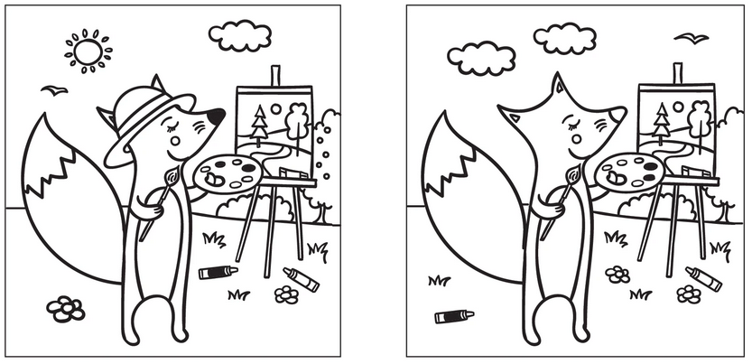
Images
How do you measure distances between images?
Vector distance won’t work
Fail when images are move by one pixel row
Earth mover’s distance

Slide 29
Earth mover’s distance
Cost of moving pixels from one image to form the other
Need to define the cost of vertical, horizontal, and diagonal movement.
This is an example of an assignment problem

Slide 30
Earth mover’s distance
Assignment problem:
Input:
N workers, N tasks
N*N Matrix: Cost of each worker doing each task
Output:
1-to-1 assignment of one
worker to one task
Minimize total cost
Min sum total matching
Solution: Hungarian algorithm
https://en.wikipedia.org/wiki/Hungarian_algorithm
$5
$10

Slide 31
Earth mover’s distance
Earth mover’s distance on vectors (1d)
Compute distance from x = (3,4,7,1) to y = (1,5,5,4)
x = (3,4,7,1) → (1,6,7,1) → (1,5,8,1) → (1,5,5,4) = y
Total cost: 2+1+3=6
2
1
3
x
y

Slide 32
Nearest neighbor classifier
How can we learn in spaces that aren’t Euclidean?
Take a base set
for example the entire sample
For each new point, give it the same label as its nearest neighbor in the base set.

Slide 33
Nearest neighbor classifier
This has infinite VC-dimension!
Proof:
For every point set, for every possible labeling
take a base set having those points with that labeling.

Slide 34
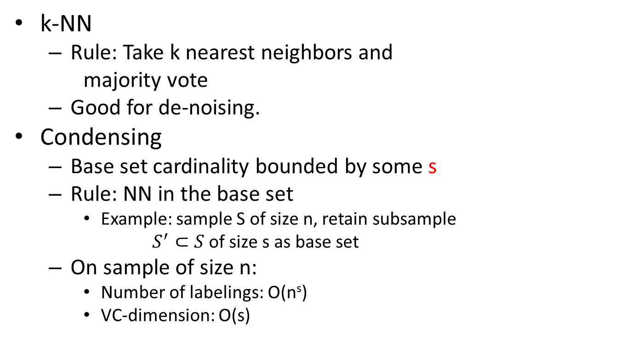
Generalization bounds
Sample
k-NN
Rule: Take k nearest neighbors and
majority vote
Good for de-noising.
Condensing
Base set cardinality bounded by some s
Rule: NN in the base set
Example: sample S of size n, retain subsample
$S^{′}⊂S$ of size s as base set
On sample of size n:
Number of labelings: O(n^{s})
VC-dimension: O(s)
Base

Slide 35
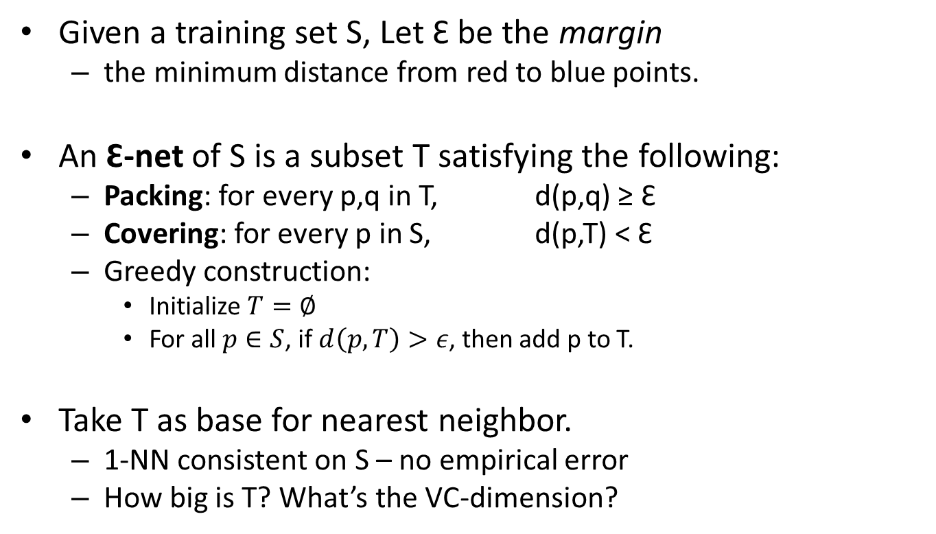
Nearest neighbor condensing
Given a training set S, Let Ɛ be the margin
the minimum distance from red to blue points.
An Ɛ-net of S is a subset T satisfying the following:
Packing: for every p,q in T, d(p,q) ≥ Ɛ
Covering: for every p in S, d(p,T) < Ɛ
Greedy construction:
Initialize $T=∅$
For all $p∈S$, if $d\left(p,T\right)>ε$, then add p to T.
Take T as base for nearest neighbor.
1-NN consistent on S – no empirical error
How big is T? What’s the VC-dimension?
S
Ɛ
T
Ɛ

Slide 36
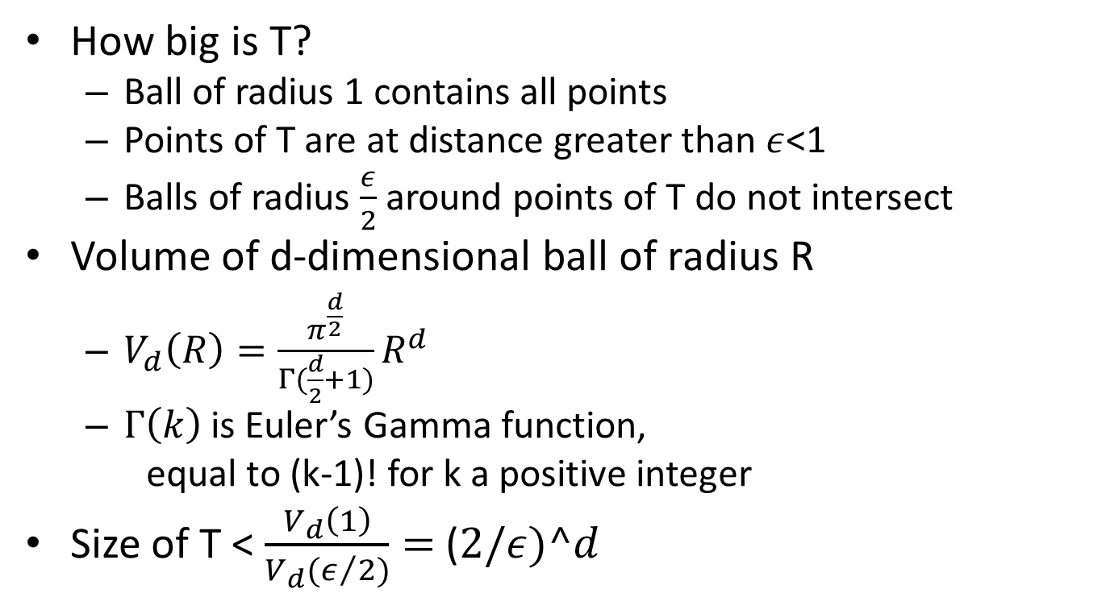
Nearest neighbor condensing
How big is T?
Ball of radius 1 contains all points
Points of T are at distance greater than $ε$<1
Balls of radius $\frac{ε}{2}$ around points of T do not intersect
Volume of d-dimensional ball of radius R
$V_{d}\left(R\right)=\frac{π^{\frac{d}{2}}}{Γ(\frac{d}{2}+1)}R^{d}$
$Γ\left(k\right)$ is Euler’s Gamma function,
equal to (k-1)! for k a positive integer
Size of T < $\frac{V_{d}\left(1\right)}{V_{d}(ε/2)}=$($2/ε)^d$
Ɛ

